Slide 1

Future prediction in Stock market
Group member:
1. Mohib billah siddiquee , id:12201043 , sec:3
2. Shah Md. Wahid, ID:13101017 , sec:3
3. Abdullah Basher Rume , id:13101015 , sec:3
4. Rafik un nabi apu , id:13101054 , sec:3
5. Arshif sharlimin siaum , Id:13101063 , sec:3

Slide 2


Slide 3


Contributions
Shah Md. Wahid – Dataset Analysis
Abdullah Basher Rume – Algorithm Analysis
Mohib Billah Siddiquee – Coding and Environment set up
Rafik un nabi apu – Result analysis
5. Arshif sharlimin siaum – Presentation making and report writing

Slide 4
Topic Explanation
Area of our work : Supervised
Have a known training dataset
Regression and classification
Specifically : Predictions
Area Covered: Data mining , Data analytics, Market trend, Market investment strategy , Risk factor analysis

Slide 5
Details About the Dataset
Columns : date, open, high, low, close, adjusted close, volume
Used columns : date, high, low, adjusted close
Output features : high, low, curves
Rows of the matrix are observations
Columns of the matrix are called predictors

Slide 6
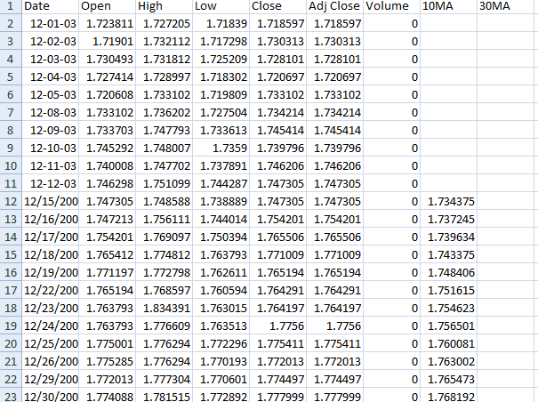

Slide 7
Algorithm Explanation
Available algorithms : Linear regression , Neural network,Decision tree,moving average crossover
Used algorithm :Moving average crossover Strategy

Slide 8
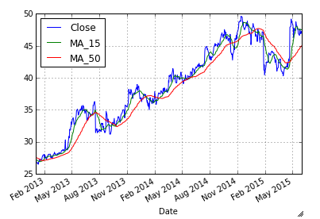

Slide 9
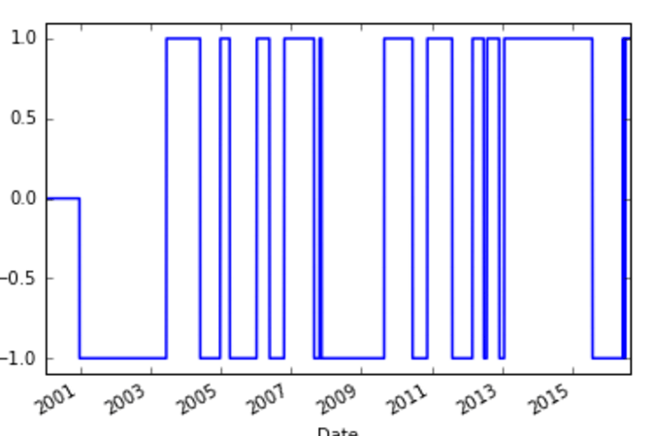

Slide 10
1. Available resources and libraries -Github -Beancoder -Libraries 2. Source code -tsr -github -youtube
Code/library explanation

Slide 11
Used Functions
Reading input
taking moving averages of 28 days and 260 days sliding window method
Convert series to frame
Adding all column together
See results in chart

Slide 12
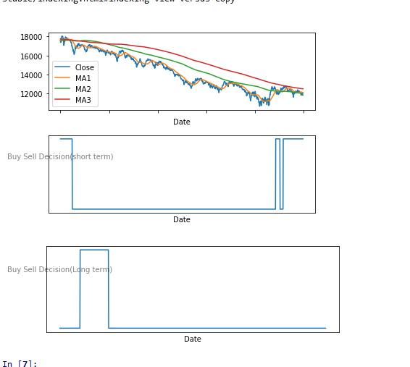
Results

Slide 13
Conclusion
We are having a plan to publish the paper
Expected outcome :
1. To find out which company’s share we can buy or sell
2. To give a time series to predict buy and sell

Slide 14
Reference
1. Retrived fromhttps://www.businesstoday.in/moneytoday/investment/predict-stock-markets-shares-movement-invest/story/20321.html
2. Retrived from, https://www.kaggle.com/pbolleddu2320/stock-market-prediction-with-python/data
3. Retrieved from http://www.statisticssolutions.com/academic-solutions/member-resources/member-profile/data-analysis-plan-templates/data-analysis-plan-multiple-linear-regression/

Slide 15


Slide 16


